Slide 1

INTRODUCTION TO CSS
Rashida Feroz Prome
ID: 1106009
Maria Noor
ID: 1106010
Md. Imrul Kayes
ID: 1106022

Slide 2
What is CSS?
CSS stands for “Cascading Style Sheets”
A style language that defines how an html document is displayed.
HTML defines the structure of the page, CSS defines how elements are displayed.

Slide 3
Types of CSS
There are three types of CSS which are given below:
Inline CSS
Internal or Embedded CSS
External CSS

Slide 4
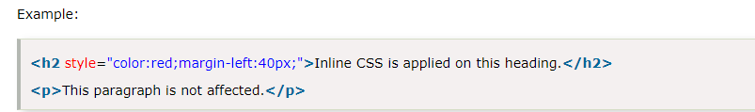
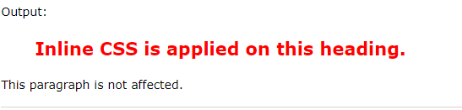
Inline css
We can apply CSS in a single element by inline CSS technique.
The inline CSS is also a method to insert style sheets in HTML document. This method mitigates some advantages of style sheets so it is advised to use this method sparingly.

Slide 5

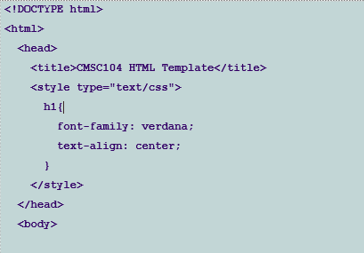
internal css
Placed in the header of the page between the <head>…</head> tags.
Contains styles that are used throughout the whole page rather than on a single tag.
Enclose each “rule” in the <style>…</style> tag.
Example:

Slide 6
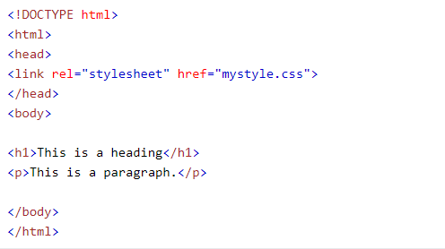
External css
The external style sheet is generally used when you want to make changes on multiple pages. It is ideal for this condition because it facilitates you to change the look of the entire web site by changing just one file.
It uses the <link> tag on every pages and the <link> tag should be put inside the head section.
Example:

Slide 7
Class & id selector
ID SELECTOR:
To select an element with a specific id, write a hash (#) character, followed by the id of the element.
CLASS SELECTOR:
To select elements with a specific class, write a period (.) character, followed by the class name.
Css code :
<head>
<style type=“text/css”>
#para1{color:red}
#para2{colore:blue}
</style>
</head>
Css code :
<head>
<style type=“text/css”>
.para1{color:red}
.para2{colore:blue}
</style>
</head>

Slide 8
Font property
The font CSS property sets the style, variant, boldness, size/line-height, and the font family for an element's text content. It is a shorthand property for setting the individual font properties i.e.
font-style
font-variant
font-weight
font-size
line-height and font-family in a single declaration.

Slide 9
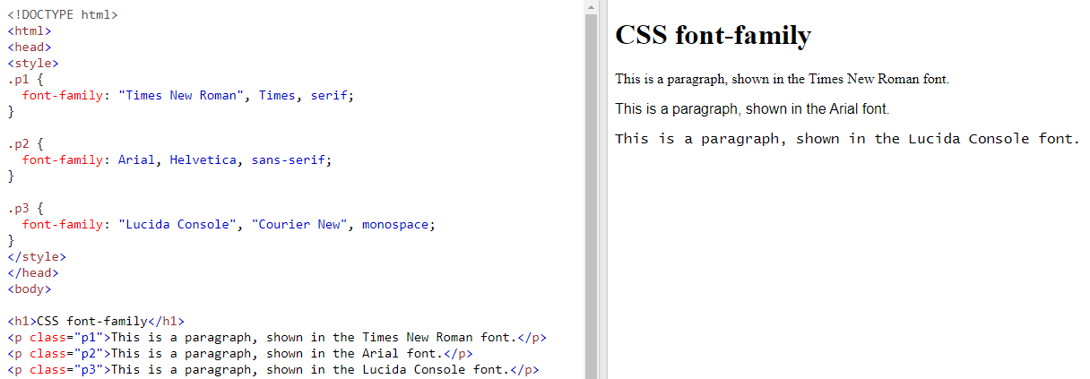
Font example
Example:
Output:

Slide 10
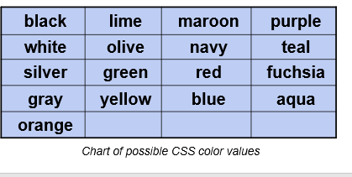
Css colore
background-color -- changes the background color
color -- changes the text color
Can be applied to most selectors. ie: body, p, etc...

Slide 11
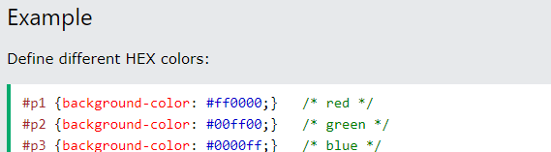
Color Example
Hexadecimal Colors
A hexadecimal color is specified with: #RRGGBB, where the RR (red), GG (green) and BB (blue) hexadecimal integers specify the components of the color. All values must be between 00 and FF.
For example, the #0000ff value is rendered as blue, because the blue component is set to its highest value (ff) and the others are set to 00.

Slide 12
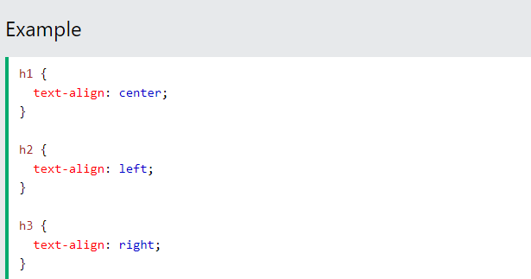
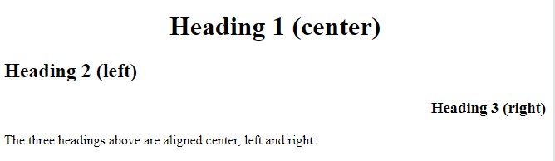
Text style
Text Alignment
The text-align property is used to set the horizontal alignment of a text.
A text can be left or right aligned, centered, or justified.

Slide 13
margin
The CSS margin properties are used to create space around elements, outside of any defined borders.
With CSS, you have full control over the margins. There are properties for setting the margin for each side of an element (top, right, bottom, and left).
CSS has properties for specifying the margin for each side of an element:
margin-top
margin-right
margin-bottom
margin-left

Slide 14
padding
The CSS padding properties are used to generate space around an element's content, inside of any defined borders.
With CSS, you have full control over the padding. There are properties for setting the padding for each side of an element (top, right, bottom, and left).
CSS has properties for specifying the padding for each side of an element:
padding-top
padding-right
padding-bottom
padding-left

Slide 15
Border
The CSS border properties allow you to specify the style, width, and color of an element's border.
The border-style property specifies what kind of border to display.
The following values are allowed:
dotted - Defines a dotted border
dashed - Defines a dashed border
solid - Defines a solid border
double - Defines a double border
groove - Defines a 3D grooved border. The effect depends on the border-color value
ridge - Defines a 3D ridged border. The effect depends on the border-color value
inset - Defines a 3D inset border. The effect depends on the border-color value
outset - Defines a 3D outset border. The effect depends on the border-color value

Slide 16
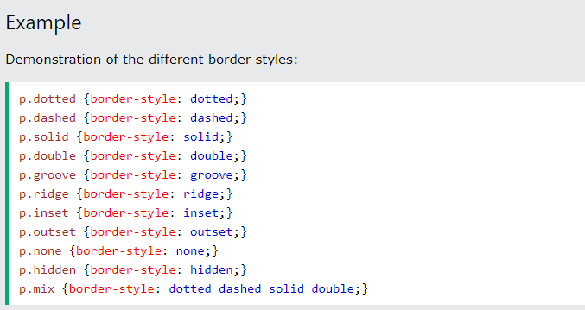
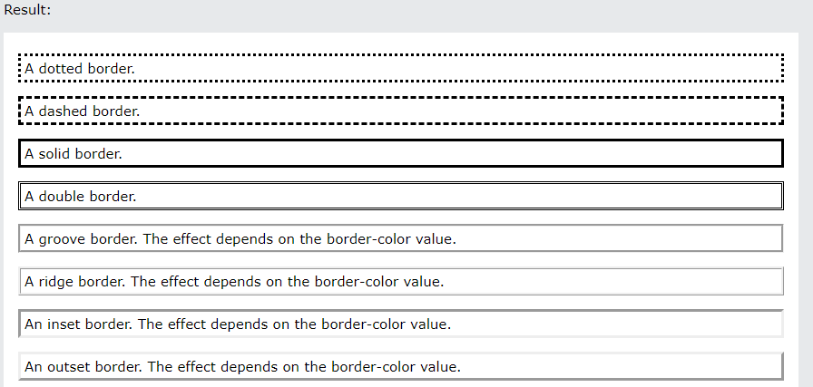
Border example

Slide 17
Box model
In CSS, the term "box model" is used when talking about design and layout.
The CSS box model is essentially a box that wraps around every HTML element.
It consists of:
Margins,
Borders,
Padding and
The actual content.

Slide 18
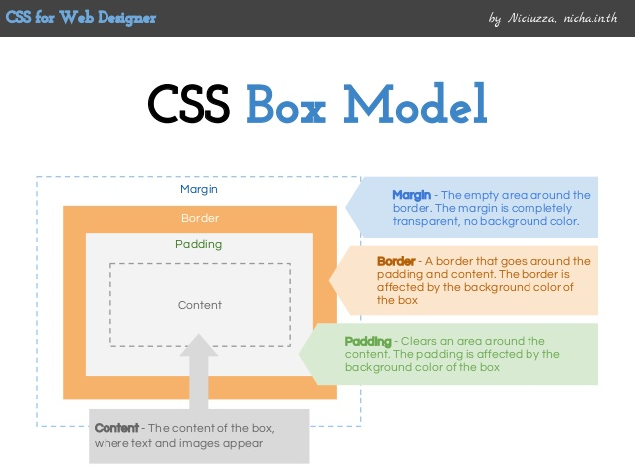
Box model
The image below illustrates the box model:

